Slide 1
Information Technology Investment: Decision Making Methodology
2nd Edition
Chapter 4
Basic Financial Methods

Slide 2
Chapter Outline:
Introduction
What are the Basic Financial Methods?
What is Breakeven Analysis?
What is Payback Period Methodology?
What is Accounting Rate of Return Methodology?
Chapter 4 Discussion Questions

Slide 3
I. Introduction
All IT investments must be justified
This chapter is the first of several chapters that is focused on fundamental financial components or “basic financial methods” expected in IT investment decision-making

Slide 4
II. What are the Basic Financial Methods?
Financial methodologies are rooted in traditional “capital budgeting decisions”
Capital budgeting decisions are those concerning investment in real assets, such as machinery, facilities, IT and management expertise
Real assets tend to be long-lived assets, often with a life of several years

Slide 5
II. What are the Basic Financial Methods?
Financial methodologies can be divided into two categories:
-basic financial methods
-advanced financial methods
Basic financial methods are often employed because of their simplicity and communicability
Advanced financial methods are often employed in more complex situations required a more detailed consideration of factors

Slide 6
II. What are the Basic Financial Methods?
Research on the Use of financial methodologies in IT evaluation:
 | Ballantine and Stray 1999 (%) | Ballantine and Stray 1998 (%) | Bacon 1992 (%)
Payback | 69 | 60 | 61
Accounting Rate of Return | 48 | 43 | 16
Net Present Value | 15 | 24 | 49
Internal Rate of Return | 15 | 25 | 54

Slide 7
III. What is Breakeven Analysis?
Breakeven analysis for IT investment involves the comparison of quantifiable costs with non-quantifiable benefits
Non-quantifiable benefits are referred to as intangible, or that monetary value can not be assigned to them
Non-quantifiable benefits can be determined by survey of employees or by expert judgment

Slide 8
III. What is Breakeven Analysis?
Steps in Breakeven Analysis:
Calculate value of costs
Calculate value of quantifiable benefits
Calculate net present value of costs/benefits
Determine non-quantifiable benefits and subjectively consider them in the analysis

Slide 9
III. What is Breakeven Analysis?
Example problem from textbook (Steps 1 & 2):
 | Year 0 | Year 1 | Year 2 | Year 3
Costs:
Initial cost ($) | 100,000
Annual cost ($) |  | 20,000 | 20,000 | 20,000
Benefits:
Improved productivity($) |  | 35,000 | 35,000 | 35,000
Improved employee morale |  | -- | -- | --
These are non-quantifiable

Slide 10
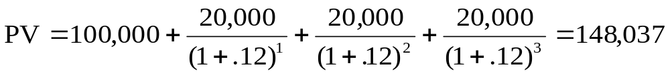
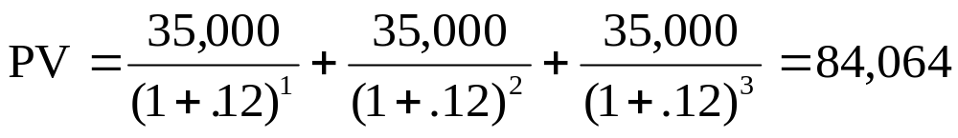
III. What is Breakeven Analysis?
Example problem from textbook (Step 3):
Type of Value | Calculations
Present value of costs ($)
Present value of tangible benefits ($)
Net Present Value= PV Costs – PV Benefits
= $148,037 - $84,064
= $63,973 (Net costs)

Slide 11
III. What is Breakeven Analysis?
Example problem from textbook (Step 4):
The $63,973 (Net Present Value of costs) has be less then the adjudged value of the non-quantifiable benefits:
-If the are, go for the IT investment, or
-If they are not, don’t go for the investment

Slide 12
IV. What is Payback Period Methodology?
Payback period is the amount of time required to recover the cost of the initial investment
The cutoff period is the pre-specified length of time in which an investment must recover its initial investment to be considered the best alternative
Payback period methodology involves selecting a suitable cutoff period and determining the payback period for each alterative investment

Slide 13
IV. What is Payback Period Methodology?
Example of Payback Period Methodology from textbook:
Decide between Alternative A or B based on payback:
 | Alternative A Computer System | Alternative B Computer System
Initial cost ($) | 40,000 | 40,000
Cash flow year 1 ($) | 30,000 | 20,000
Cash flow year 2 ($) | 15,000 | 10,000
Cash flow year 3 ($) | 25,000 | 30,000
Cash flow year 4 ($) | 35,000 | 40,000

Slide 14
IV. What is Payback Period Methodology?
Example of Payback Period Methodology from textbook:
The quicker the payback, the better the alternative:
 | Alternative A Computer System | Sum of cash flow for Computer A | Alternative B Computer System | Sum of the cash flow for Computer B
Initial Cost ($) | 40,000 | - | 40,000 | -
Cash flow year 1 ($) | 30, 000 | 30,000 | 20,000 | 20,000
Cash flow year 2 ($) | 15,000 | 45,000 | 10,000 | 30,000
Cash flow year 3 ($) | 25,000 | 70,000 | 30,000 | 60,000
Cash flow year 4 ($) | 35,000 | 105,000 | 40,000 | 100,000
Alternate A payback
in Year 2 >>>>
Alternate B payback
in Year 3>>>>

Slide 15
V. What is Accounting Rate of Return Methodology?
Accounting rate of return (ARR) where the accounting rate of return is compared to a cutoff rate of return
ARR, also called book rate of return is the average annual income from an investment divided by the average annual book value of the initial investment cost
ARR = average annual net income
average annual book assets
ARR simply measures income or cash flow as a proportion of the initial investment amount

Slide 16
V. What is Accounting Rate of Return Methodology?
Example from textbook: First compute the average annual net income data, then average it
 | Year 1 | Year 2 | Year 3
Cash inflow ($) | 50,000 | 30,000 | 40,000
Depreciation ($) | 30,000 | 30,000 | 30,000
Net income ($) | 20,000 | 0 | 10,000
Average annual net income = $10,000
Average annual net income=$20,000+0+$10,000/3
=$10,000

Slide 17
V. What is Accounting Rate of Return Methodology?
Example from textbook: Next average annual book value of assets from initial investment, then average it
 | Year 0 | Year 1 | Year 2 | Year 3
Gross book value of asset ($) | 90,000 | 90,000 | 90,000 | 90,000
Cumulative Depreciation ($) | 0 | 30,000 | 60,000 | 90,000
Net book value of asset ($) | 90,000 | 60,000 | 30,000 | 0
Average annual book assets = $45,000
Average annual net income=$90,000+$60,000+$30,000+0/4
=$45,000

Slide 18
V. What is Accounting Rate of Return Methodology?
Example from textbook: Finally, we compute the ARR, then compare it with alternatives
ARR = average annual net income
average annual book assets
$10,000 = 0.222 or 22.2%
45,000
As long as the AAR is larger than a cutoff rate (perhaps the interest rate the company pays on its loans, say 10%), then the investment is a good one. If it less, it is not a good one.

Slide 19
VI. Chapter 4 Discussion Questions
1. Why use “breakeven analysis” in IT investment decision making?
2. Why are non-quantifiable benefits an issue in “breakeven analysis”?
3. Why use the “payback period method” in IT investment decision making?
4. Why use the “accounting rate of return” in IT investment decision making?
5. Why use “breakeven analysis” over say the “payback period method”?
6. Explain how not taking into consideration the time value of an investment can cause a problem when using the “payback period method”?
7. Why use “breakeven analysis” over say the “accounting rate of return”?
8. Why is the classification of costs so important when using the “accounting rate of return” in IT investment decision making?
9. Why use “payback period method” over say the “accounting rate of return”?
10. Why were two formulas for “accounting rate of return” given? Explain the need for both.
11. How can accounting book values disrupt an “accounting rate of return” analysis?
END OF CHAPTER 4

